Slide 1


Spotify Playlist Extender – Emotion-Aware Recommender System
Combining Data Science with Music Personalization
Team Members: Yashvardhan | Tanishq Patil | Sairaj Sirsat

Slide 2

Project Objective: Enriching the Listening Experience
Intelligent Playlist Extension
Emotional and Lyrical Context
The primary goal is to intelligently extend existing Spotify playlists by leveraging data science and Natural Language Processing (NLP) techniques.
We aim to understand the underlying emotional and lyrical themes of songs, moving beyond simple metadata to capture the true context of the music.
Thematically Consistent Recommendations
The system generates recommendations for tracks that are not only musically similar but also emotionally and thematically consistent, thus enriching the user's listening flow.

Slide 3


Bridging the Gap: The Problem Statement
The Limitation of Standard Recommenders
Spotify’s existing recommendation algorithms are highly effective but primarily rely on musical metadata such as tempo, artist similarity, genre tags, and track features (e.g., danceability).
However, they often lack a deep, semantic understanding of the music's lyrical content. They cannot discern the emotional tone or core theme conveyed by the lyrics.
This project addresses this functional gap by combining sentiment and theme analysis, delivering sophisticated, emotion-aware track suggestions to the user.

Slide 4







System Workflow: A Seven-Step Process
Our end-to-end recommender system follows a systematic flow from user authentication to automatic playlist update.
Spotify OAuth Authentication
Securely gaining access to the user's Spotify account and playlist data.
Playlist Extraction
Retrieving the target playlist's track list and basic metadata.
Lyrics Retrieval (Genius API)
Fetching lyrics for each track using the Genius API for textual analysis.
Sentiment & Theme Analysis
Applying NLP techniques to determine the prevalent emotional tone and themes.
Insight Generation
Compiling a thematic profile (e.g., 60% Nostalgia, 20% Positive Sentiment).
Recommendation Generation
Searching Genius and cross-matching with Spotify for highly relevant tracks.
Automatic Playlist Update
Final selection of tracks is automatically added to the user's Spotify playlist.

Slide 5




Core Tools and Technologies
The project successfully integrates multiple APIs and leverages robust Python libraries to handle data flow, text processing, and platform interaction.
Spotify API (Spotipy)
Genius API & BeautifulSoup
Used for all interactions with Spotify, including secure authorization, playlist access, and final track modification.
Crucial for the reliable extraction of accurate and structured lyrical content from the web and the Genius platform.
Python Libraries
NLP & Keyword Detection
Essential dependencies like requests, re (Regular Expressions), json, Counter, and time manage the script's operational logic and data handling.
The intelligence core, employing keyword-based dictionaries for rapid and effective sentiment and thematic profiling of the lyrics.

Slide 6

Methodology: Analyzing Lyrical Emotion
Detailed Analysis Breakdown
Sentiment Analysis: Performed using a refined keyword dictionary to classify the lyrical tone into three core categories: Positive, Negative, or Neutral.
Theme Detection: Focused on identifying pervasive emotional narratives such as Romance, Heartbreak, Nostalgia, Hope, and Longing.
Recommendation Generation: Candidate tracks are first identified via Genius search based on the detected themes. These tracks are then cross-referenced and validated on Spotify for official integration.
Automation of Update: The final list of recommended songs is passed back to the Spotify API via Spotipy, ensuring seamless addition to the specified user playlist.

Slide 7
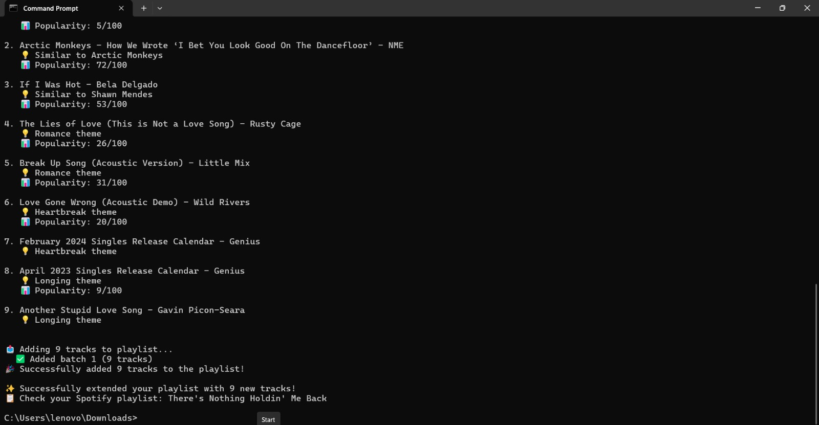
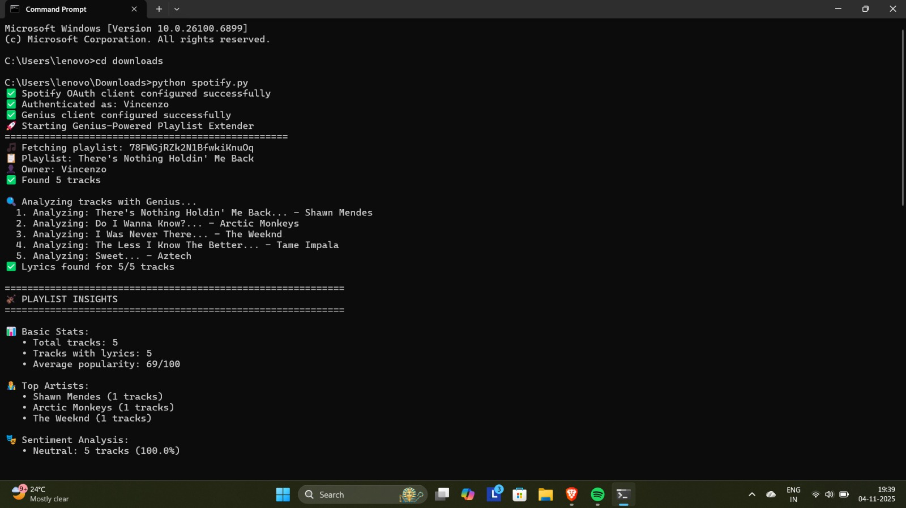
Implementation: Console Output Snapshot
This screenshot captures a successful run, demonstrating the system's ability to analyze a playlist, calculate sentiment distribution, and present relevant track recommendations.
Successful playlist analysis and extension using the integrated Spotify and Genius APIs demonstrates the system's operational capability.

Slide 8
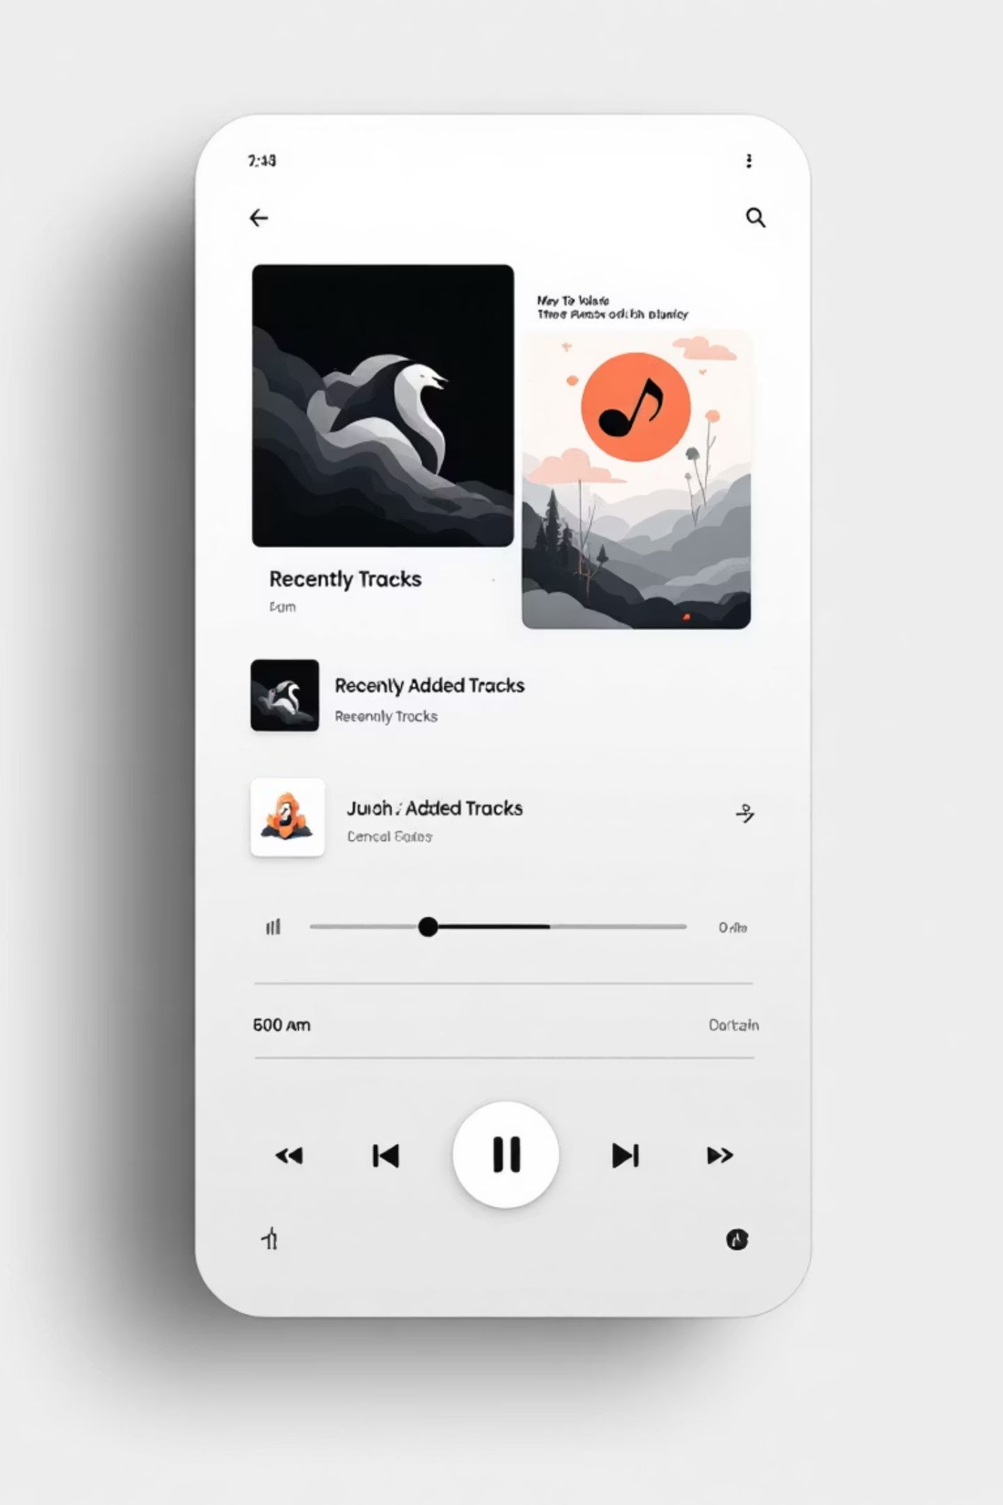




Results and Verified Outcomes
Accurate Detection
Successfully achieved high accuracy in lyrical and sentiment detection across diverse music genres, confirming the effectiveness of the keyword-based NLP model.
Emotionally Consistent Extension
Playlists were extended with new tracks that maintained the original emotional core, providing a seamless and enjoyable listening experience.
End-to-End Automation
The entire process, from data retrieval and analysis to the final playlist update, operates fully autonomously, minimizing manual intervention.
Functionality Across Multiple Playlists
System functionality has been verified across various user-provided playlists, demonstrating robustness and adaptability.

Slide 9
Key Insights and Observations
The analysis of several test playlists yielded valuable insights into popular lyrical themes and the overall emotional distribution of user-curated music.
~69/100
3
1.0
Average Popularity
Common Detected Themes
Sentiment Balance
The recommended tracks typically held an average Spotify popularity score of ~69, indicating high quality and listenability.
The most frequently identified themes were love, nostalgia, and hope, suggesting these are primary emotional drivers for personalized playlists.
Test playlists generally exhibited a balanced distribution of emotional tones (positive, negative, and neutral) rather than extremes.
These observations confirm that integrating emotional context provides a significant uplift in the relevance and quality of music recommendation.

Slide 10



Conclusion and Future Scope
The Spotify Playlist Extender successfully merges AI, NLP, and multiple APIs to create a smarter, more nuanced recommendation system that is closer to human understanding.
Advanced Sentiment Analysis
Include Audio Features
Web/GUI Interface Development
Incorporate technical audio features (tempo, energy, danceability, acousticness) from Spotify to enhance the blend of emotional and sonic recommendations.
Integrate state-of-the-art models like BERT or spaCy to move beyond keyword matching, enabling deeper contextual understanding of lyrical complexity.
Develop a user-friendly web-based application or a graphical user interface (GUI) to make the system accessible to a wider audience.

